Slide 1

Computer Organization And Architecture
CSE-209
Lecture – 13
Al Bashir
Lecturer, Dept. of CSE
Dhaka International University

Slide 2
Content
Parallel Processing

Slide 3
What is Parallel Processing?
Parallel processing is a method of simultaneously breaking up and running program tasks on multiple microprocessors, thereby reducing processing time. Parallel processing may be accomplished via a computer with two or more processors or via a computer network.
Parallel processing is also called parallel computing.

Slide 4
Parallel Processing
Parallel Processing Systems are designed to speed up the execution of programs by dividing the program into multiple fragments and processing these fragments simultaneously.
Such systems are multiprocessor systems also known as tightly coupled systems.
Parallel systems deal with the simultaneous use of multiple computer resources that can include a single computer with multiple processors, a number of computers connected by a network to form a parallel processing cluster or a combination of both.

Slide 5
Parallel Processing
Traditionally, the computer has been viewed as a sequential machine. Most computer programming languages require the programmer to specify algorithms as sequences of instructions. Processors execute programs by executing machine instructions in a sequence and one at a time. Each instruction is executed in a sequence of operations (fetch instruction, fetch operands, perform operation, store results).

Slide 6
Types of Parallel Processor Systems
A taxonomy first introduced by Flynn [FLYN72] is still the most common way of categorizing systems with parallel processing capability. Flynn proposed the following categories of computer systems:
1. Single instruction, single data (SISD) stream: A single processor executes a single instruction stream to operate on data stored in a single memory. Uniprocessors fall into this category.

Slide 7
Types of Parallel Processor Systems
2. Single instruction, multiple data (SIMD) stream: A single machine instruction controls the simultaneous execution of a number of processing elements on a lockstep basis.
Each processing element has an associated data memory, so that each instruction is executed on a different set of data by the different processors.

Slide 8
Types of Parallel Processor Systems
3. Multiple instruction, single data (MISD) stream: A sequence of data is transmitted to a set of processors, each of which executes a different instruction sequence. This structure is not commercially implemented.
4. Multiple instruction, multiple data (MIMD) stream: A set of processors simultaneously execute different instruction sequences on different data sets. SMPs, clusters, and NUMA systems fit into this category.

Slide 9
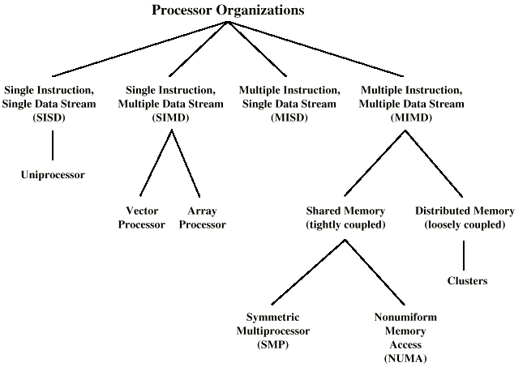
Taxonomy of Parallel Processor Architectures

Slide 10
Parallel Organizations
There is some sort of control unit (CU) that provides an instruction stream (IS) to a processing unit (PU). The processing unit operates on a single data stream (DS) from a memory unit (MU).
With an SIMD, there is still a single control unit, now feeding a single instruction stream to multiple PUs. Each PU may have its own dedicated memory (illustrated in Fig. b), or there may be a shared memory.
Finally, with the MIMD, there are multiple control units, each feeding a separate instruction stream to its own PU.

Slide 11
Parallel Organizations
The MIMD may be a shared-memory multiprocessor (Figure 17.2c) or a distributed-memory multicomputer (Fig.d).
The design issues relating to SMPs, clusters, and NUMAs are complex, involving issues relating to physical organization, interconnection structures, inter-processor communication, operating system design, and application software techniques.

Slide 12
Parallel Organizations
The MIMD may be a shared-memory multiprocessor (Figure 17.2c) or a distributed-memory multicomputer (Fig.d).
The design issues relating to SMPs, clusters, and NUMAs are complex, involving issues relating to physical organization, interconnection structures, inter-processor communication, operating system design, and application software techniques.

Slide 13
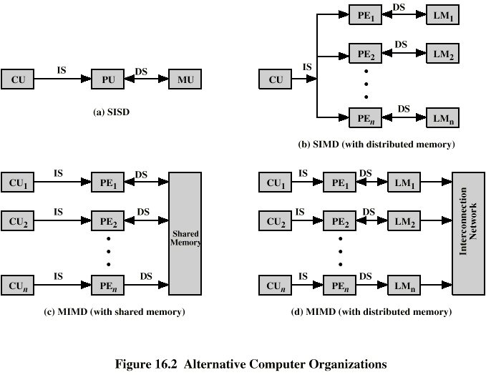
Parallel Organizations - SISD

Slide 14
Parallel Organizations - SIMD

Slide 15
Parallel Organizations - MIMD Shared Memory

Slide 16
Parallel Organizations - MIMD Distributed Memory

Slide 17
Symmetric Multiprocessors
A stand alone computer with the following characteristics
Two or more similar processors of comparable capacity
Processors share same memory and I/O
Processors are connected by a bus or other internal connection
Memory access time is approximately the same for each processor
All processors share access to I/O
Either through same channels or different channels giving paths to same devices
All processors can perform the same functions (hence symmetric)
System controlled by integrated operating system
providing interaction between processors
Interaction at job, task, file and data element levels

Slide 18
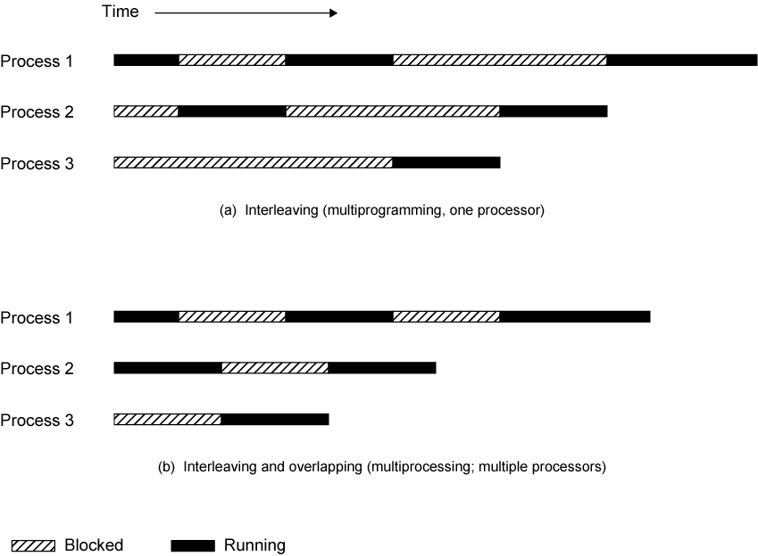
Multiprogramming and Multiprocessing

Slide 19
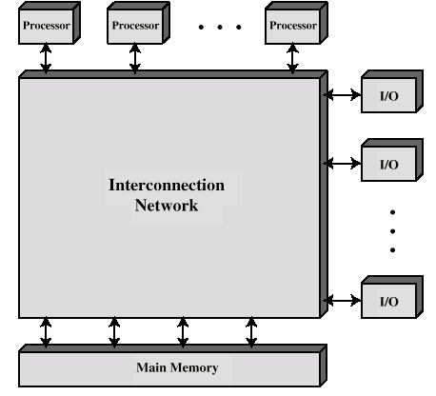
Block Diagram of Tightly Coupled Multiprocessor

Slide 20
Organization Classification
Time shared or common bus
Multiport memory
Central control unit

Slide 21
Time Shared Bus
Simplest form
Structure and interface similar to single processor system
Following features provided
Addressing - distinguish modules on bus
Arbitration - any module can be temporary master
Time sharing - if one module has the bus, others must wait and may have to suspend
Now have multiple processors as well as multiple I/O modules

Slide 22
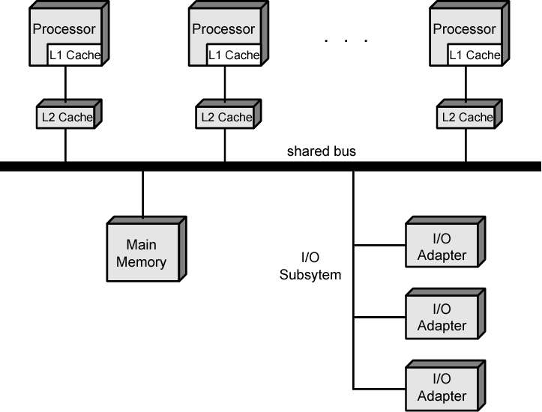
Symmetric Multiprocessor Organization

Slide 23
Time Share Bus –Advantages & Disadvantage
Advantages
Simplicity
Flexibility
Reliability
Disadvantage
Performance limited by bus cycle time
Each processor should have local cache
Reduce number of bus accesses
Leads to problems with cache coherence
Solved in hardware

Slide 24
Question??

Slide 25
Thanks

